Slide 1
CS777 Final Project
Christopher Liu

Slide 2
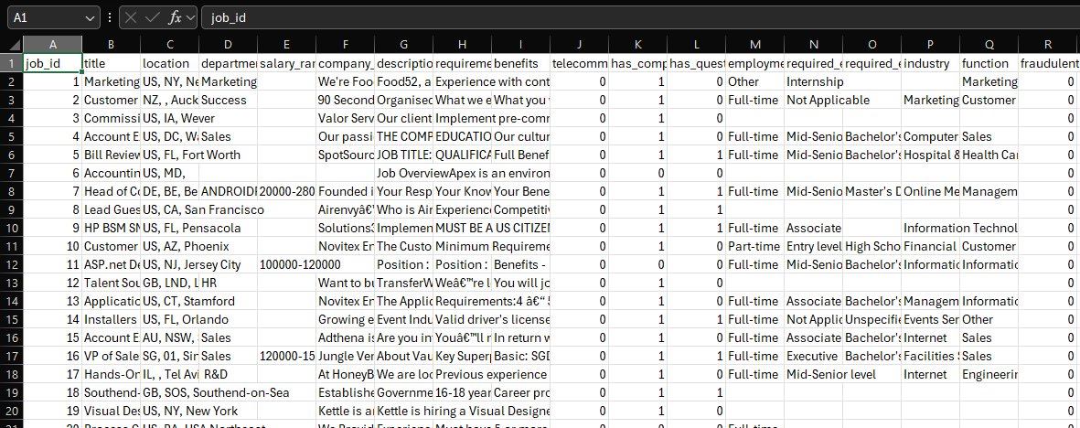
Dataset
https://www.kaggle.com/datasets/shivamb/real-or-fake-fake-jobposting-prediction

Slide 3
Exploring the Data
We have around 17880 rows of job data within this dataset
However, there are about 800 fake job listings within the data, this results in a highly imbalanced dataset
The dataset includes several key features
Some are Categorical features, this includes employment type(full time, part time etc), Experience Level, Education level
We also have some binary features, such as: Telecommunication (allows for remote work), has a company logo (fake companies may not have this)
Finally, we also have some textual features, this includes the job description.
We can try to use some NLP methods to see if we can track down a pattern that can help differentiate between real and fake listings

Slide 4




Task and why this is relevant
In 2023 alone, around 12 million Americans were searching for employment in any given month.
This results in opportunities for companies and businesses to acquire new skilled laborers and talent.
However, this creates opportunities for other individuals to take advantage of job seekers.
Fraudulent job postings are on the rise as sites(pictured right) often do not verify if certain companies are legitimate or not.
Fraudulent job’s can lead to individuals being scammed by malicious actors of their money, time, and even identity.

Slide 5
Task continued
As a result of this, we can utilize ML models and even AI to help potential job seekers identify and report fraudulent postings.
The goal of this project is to leverage ML models to identify fraudulent postings utilizing the structured and textual data given to us in job postings.
We want to attempt to handle our imbalanced dataset by using oversampling techniques.

Slide 6
Models Used
Classification Models used:
Logistic Regression (As a baseline)
Works well with binary classification(in this case fraudulent or not)
Decision Tree
Random Forest
Naïve Bayes
Should be good for textual data
Gradient Boosting
Should perform the best

Slide 7
Processing the data
Had to fill in missing data: (isNull)
Some categorical features such as employment type, required experience etc were null
Encode categorical data into numerical labels (stringindexer)
So the ML models can work with them
Handle some categories with high cardinal features (stringindexer)
Industry and function labels had many unique values
Class imbalance issue
Had to oversample fraudulent jobs as there were only around 800 vs 17000 real jobs
Test Train split
80% of the data was utilized for training and the other 20% for testing

Slide 8
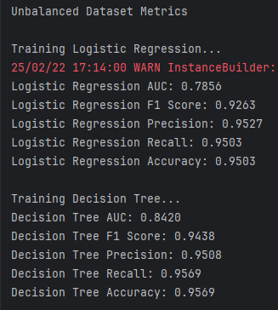
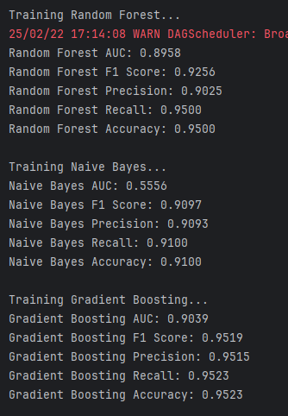
Results
Some of the key observations here is that with the unbalanced dataset our models perform quite well
Gradient Boosting performed the best with an AUC score of 0.9039, F1 of .9519 and a 95% accuracy.
Logistic regression also performed well but would struggle to separate fraud vs non fraud due to its AUC score being lower.
The Naïve Bayes Model had the worst performance, the low AUC represents that even flipping a coin our odds would be similar.
Seeing this, we can surmise that the models have enough features to predict fraudulent jobs on, even though the dataset is imbalanced to some degree

Slide 9
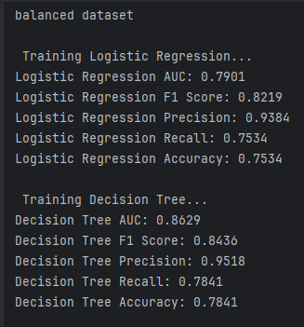
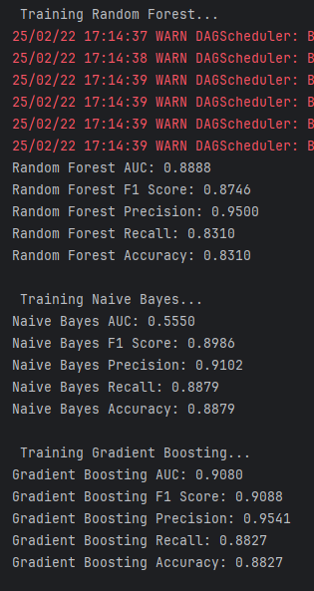
Results Cont.
Gradient Boosting still outperforms other models, achieving the highest AUC and F1 scores.
Our Random forest and Decision Tree scores improved over the unbalanced dataset, showing that oversampling did help boost scores.
However, our LR scores dropped quite a bit, concerning our f1, Recall, and Accuracy.
This shows that it somehow struggles more with balanced data.
Naïve Bayes still performs the worst out of the bunch.

Slide 10
Results with TF-IDF(Term frequency-inverse document frequency)
Why use TF-IDF?
Job descriptions are often tell-tale signs of fraudulent postings, certain grammar choices and words can give away whether a job is real.
This can come as exaggerated claims, vague wording or unusual phrasing.
Some job postings can be “too good to be true”, such as “Earn 3000 a week from your home!” or “no experienced required!”
TF-IDF is used in spam detection and fake review detection as well.
Utilizing Text Features, we can see if TF-IDF can help identify fraudulent postings from job descriptions

Slide 11
TF-IDF considerations
This may backfire as TF-IDF may not detect strong differences between legitimate and fraudulent postings.
Other features present may already do a better job.
Some structured features such as has_company_logo or telecommunicating may be better at prediction.
TF-IDF suffers in comparison to Word2Vec as it doesn’t understand context of said word.
However, Word2Vec’s implementation later will prove to be difficult in my case.

Slide 12
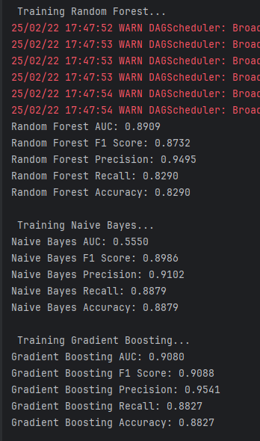
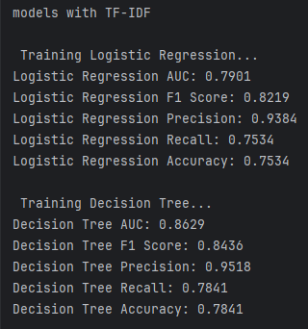
Results with TF-IDF Cont.
This is using the balanced dataset with TF-IDF features.
We do not see a significant change when incorporating these features.
This tells us that textual features do not add to each model's performance.
This can be a result of how as mentioned earlier, textual features between legitimate and fraudulent job postings may be similar.
And that our previous features do a good job at prediction already.

Slide 13
Future implementation
This project would be scalable and can be used with big data.
By utilizing Pyspark this script can be run on Google Cloud or AWS if needed.
This script an be used with Apache Kafka for data streaming.
This means when integrated into job posting sites, jobs can be preemptively scanned to flag against fraudulent postings.
A real-world use case would be to integrate this into job posting sites, so that moderators have tools to periodically scan for fraudulent listings, protecting job seekers and verifying legitimate employers.

Slide 14
Errors and Issues
Plenty
From the beginning the dataset was highly imbalanced.
Preprocessing was a must
However, there were several high cardinality features, this made binning difficult and time consuming
Word2Vec implementation failed.
Had issues with assembling features, as my features couldn’t be flattened properly, I was unable to implement this in time.
Word2Vec would’ve given us different results, as word context would’ve been considered as well, leading to better analysis.

Slide 15


Final Thoughts
This was quite a fun little project to do.

Slide 16
Thank You
Now to study for the final…

Slide 17
Works cited
Fennell, A. (2024, October 9). Job search statistics US 2025: Latest Data & Analysis. StandOut CV | Create a winning CV in minutes with our simple CV builder. https://standout-cv.com/usa/stats-usa/job-search-statistics-us
Job scams explained. consumer.gov. (2024, December 19). https://consumer.gov/scams-identity-theft/job-scams-explained

